Slide 1


Slide 2
A Database model defines the logical design and structure of a database and defines how data will be stored, accessed and updated in a database management system.

Slide 3
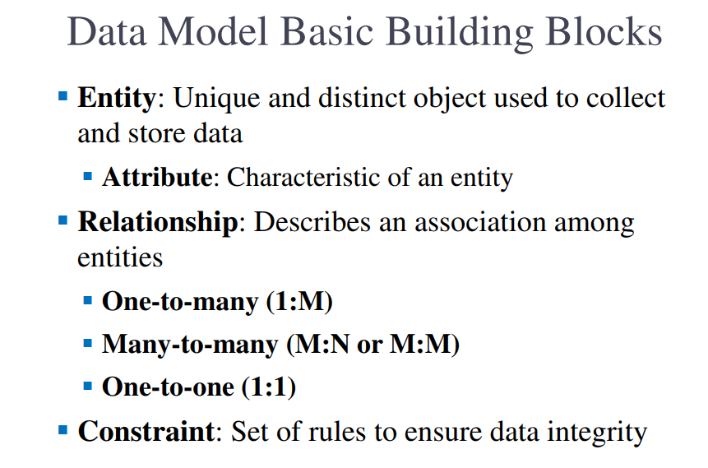

Slide 4
Hierarchical data model
A hierarchical data model is a data model which the data is organized into a tree like structure.
The structure allows repeating information using parent/child relationships.
Each parent can have many children but each child only has one parent.
All attributes of a specific record are listed under an entity type.

Slide 5


Slide 6
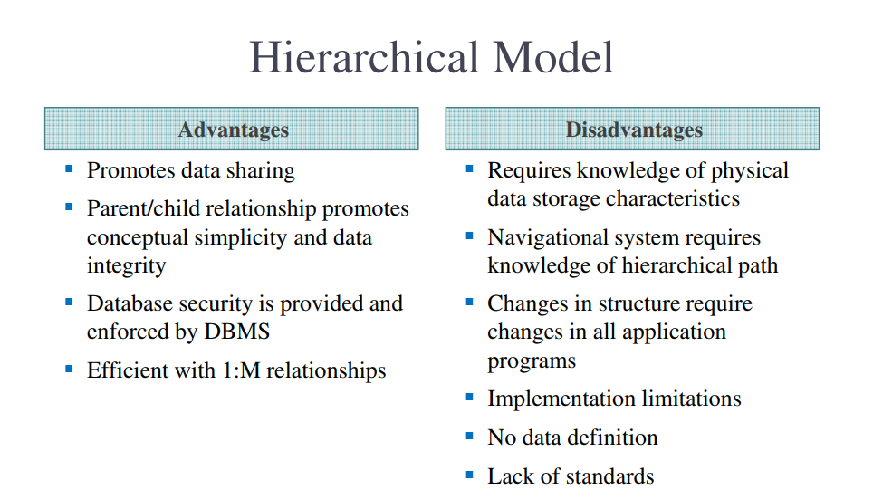

Slide 7
Network model
The data in the network model are represented by collection of records and relationships among data are represented by links, which can be viewed as pointers.s

Slide 8


Slide 9
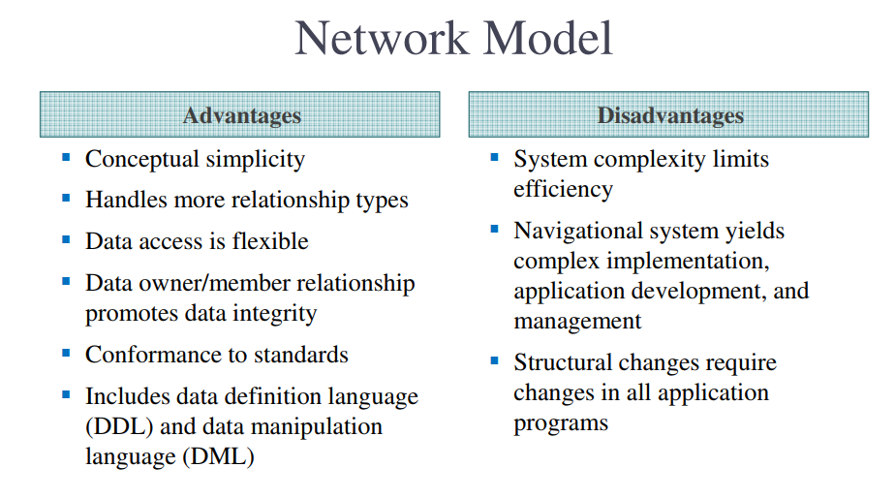

Slide 10
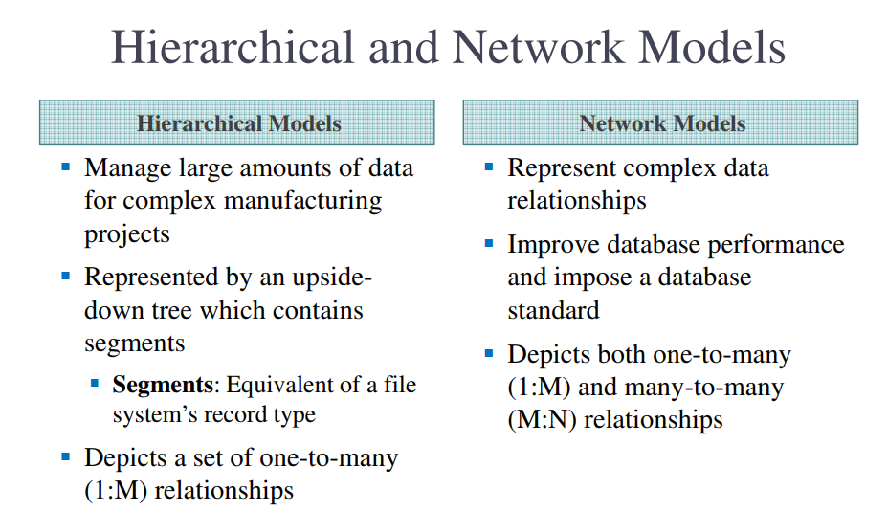

Slide 11
object database model
An object database model is a model in which information is represented in the form of objects as used in object-oriented programming.
Object databases are different from relational databases which are table-oriented.
Object-relational databases are a hybrid of both approaches.

Slide 12
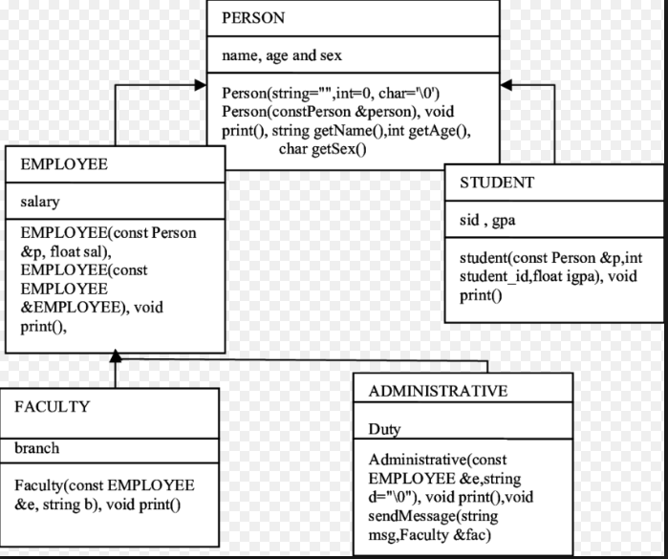

Slide 13
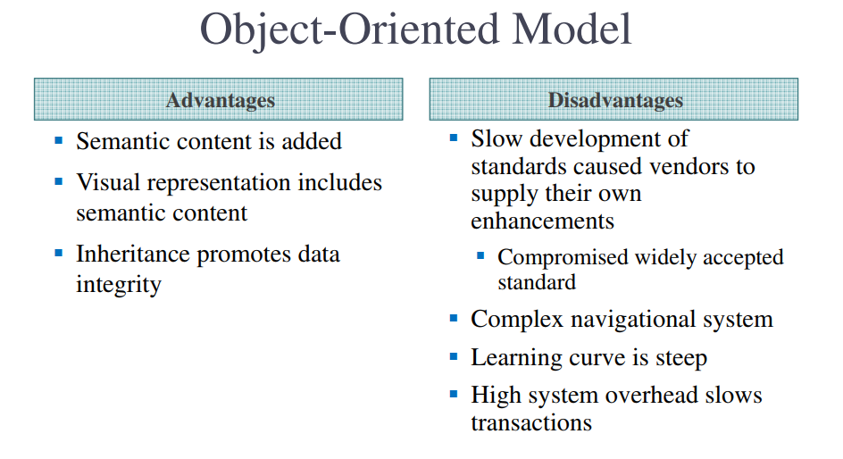

Slide 14
Relational Model
The Relational Model uses a collection of tables both data and the relationship among those data. Each table have multiple column and each column has a unique name .

Slide 15

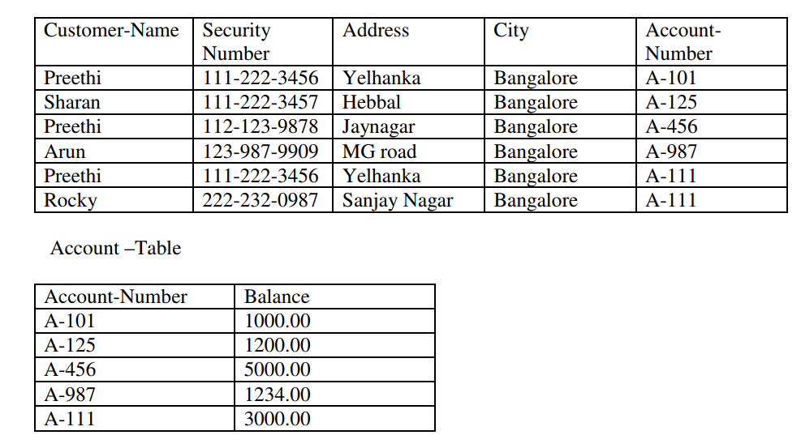

Slide 16
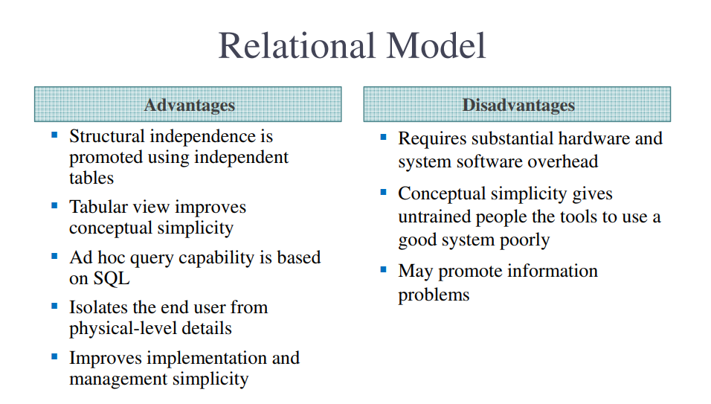

Slide 17
ER Data Model
The ER model defines the conceptual view of a database. It works around real-world entities and the associations among them.

Slide 18


Slide 19
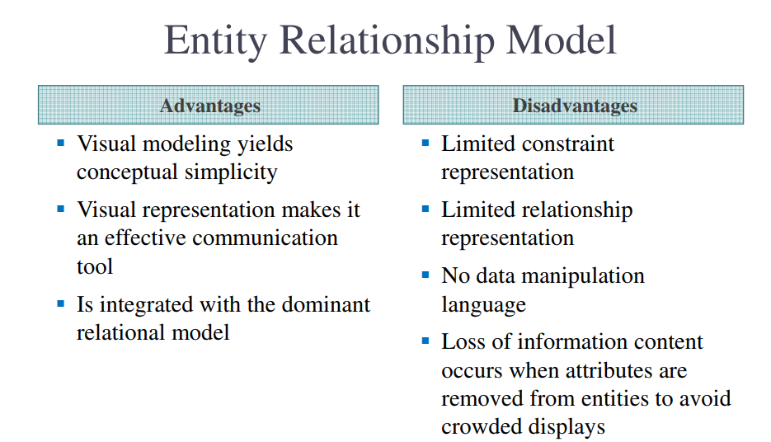

Slide 20
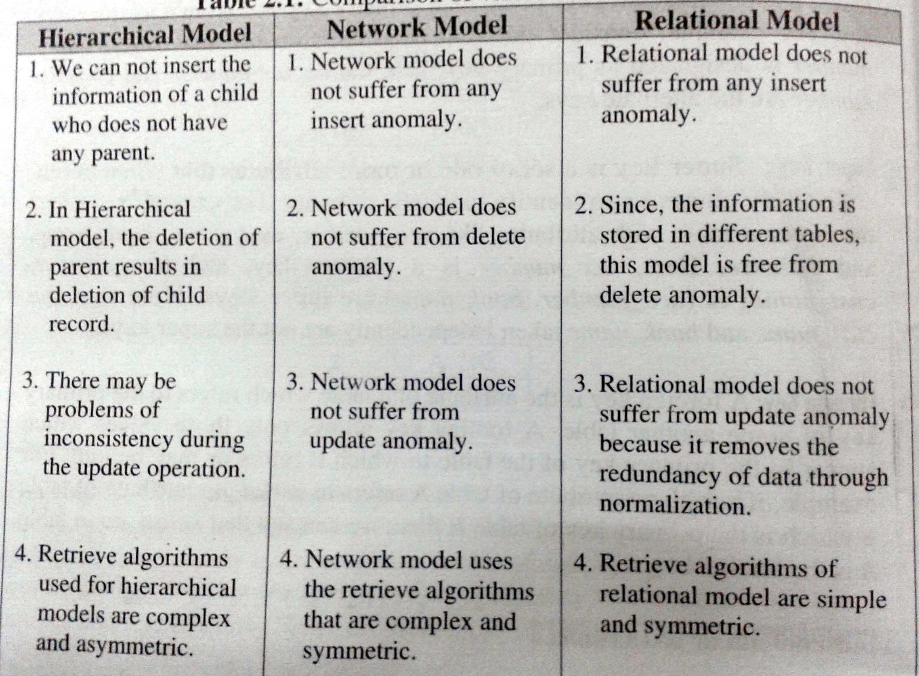

Slide 21
keys in DBMS
Key plays an important role in relational database
it is used for identifying unique rows from table.
It also establishes relationship among tables.

Slide 22
Types of keys in DBMS
Primary key
Candidate Key
Alternate Key
Supper or Composite key
Foreign key

Slide 23
Types of keys in DBMS
Primary Key – A primary is a column or set of columns in a table that uniquely identifies tuples (rows) in that table.
Candidate Key – A super key with no redundant attribute is known as candidate key
Alternate Key – Out of all candidate keys, only one gets selected as primary key, remaining keys are known as alternate or secondary keys.

Slide 24
Types of keys in DBMS
Super Key or Composite Key– A super key is a set of one of more columns (attributes) to uniquely identify rows in a table.
Foreign Key – Foreign keys are the columns of a table that points to the primary key of another table. They act as a cross-reference between tables.

Slide 25
Primary key
Example: Student Table
In the above Student table, the Stu_Id column uniquely identifies each row of the table.
Stu_Id | Stu_Name | Stu_Age
101 | Steve | 23
102 | John | 24
103 | Robert | 28
104 | Carl | 22
The value of primary key should be unique for each row of the table. Primary key column cannot contain duplicate values.
Primary key column should not contain nulls.

Slide 26
Let’s take an example to understand this: Employee table
Emp_SSN | Emp_Number | Emp_Name
123456789 | 226 | Steve
999999321 | 227 | Ajeet
888997212 | 228 | Chaitanya
777778888 | 229 | Robert

